Slide 1
Chapter No.2 Machine Cycle

Slide 2
Machine cycle
The machine cycle is the most basic operation that a computer performs, and in order to complete menial tasks such as showing a single character on the screen, the CPU has to perform multiple cycles.

Slide 3
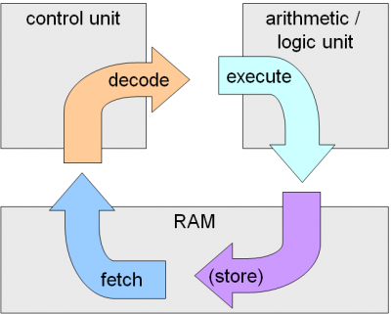
Steps
Four steps of machine cycle
Fetch
Decode
Execute
Store

Slide 4
Fetch
Retrieve an instruction from the memory.
The control unit requests instructions from the main memory that is stored at a memory’s location as indicated by the program counter (also known as the instruction counter).

Slide 5
Decode
Translate the retrieved instruction into a series of computer commands.
Received instructions are decoded in the instruction register. This involves breaking the operand field into its components based on the instruction’s operation code (opcode).

Slide 6
Execute
Execute the computer commands.
This involves the instruction’s opcode as it specifies the CPU operation required. The program counter indicates the instruction sequence for computer. These instructions are arranged into the instructions register and as each are executed, it increments the program counter so that the next instruction is stored in memory. Appropriate circuitry is then activated to perform the requested task. As soon as instructions have been executed, it restarts the machine cycle that begins the fetch step.

Slide 7
Store
Send and write the results back in memory.

